Slide 1



Telangana Tourism Dashboard
View in Power BI
MEHAKDEP SINGH
Last data refresh:
5/12/2023 3:28:06 PM UTC
Downloaded at:
5/12/2023 6:47:35 PM UTC

Slide 2
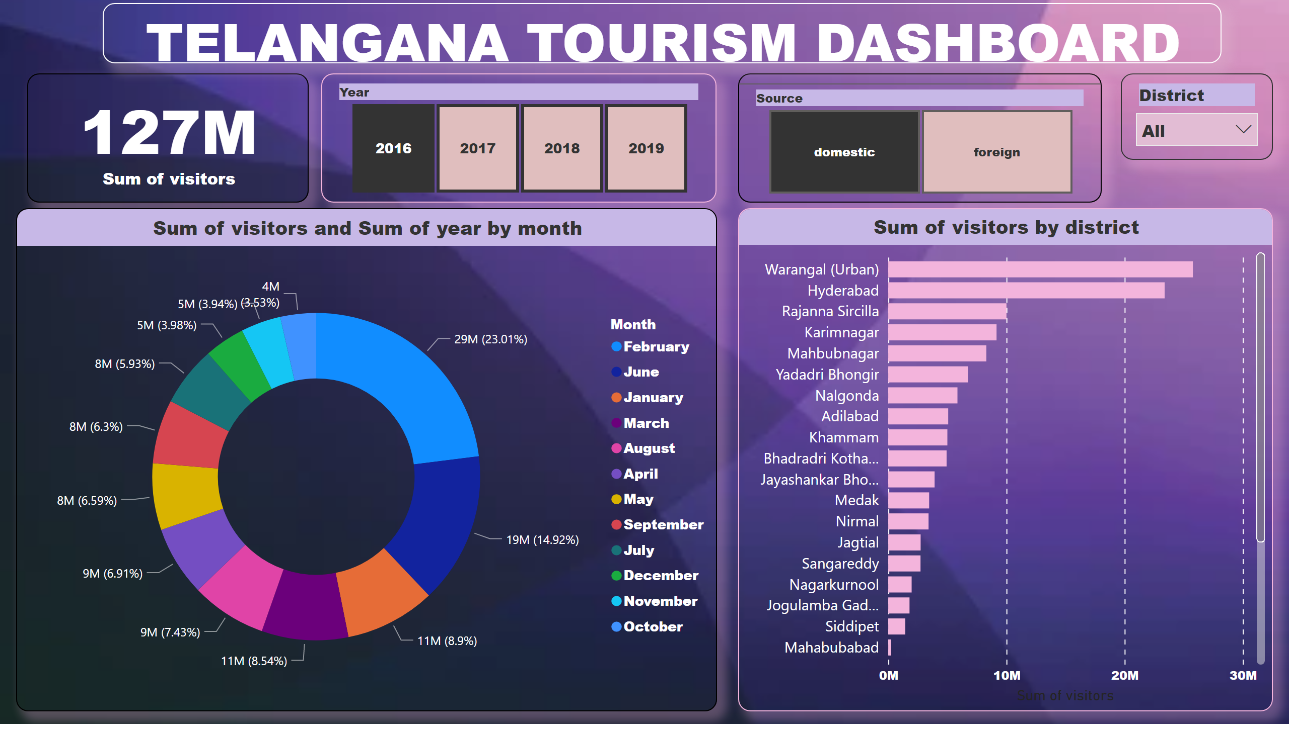
Page 1
Notes:
card
No alt text provided
slicer
No alt text provided
slicer
No alt text provided
donutChart
No alt text provided
barChart
No alt text provided
slicer
No alt text provided
TELANGANA TOURISM DASHBOARD
No alt text provided

Slide 3
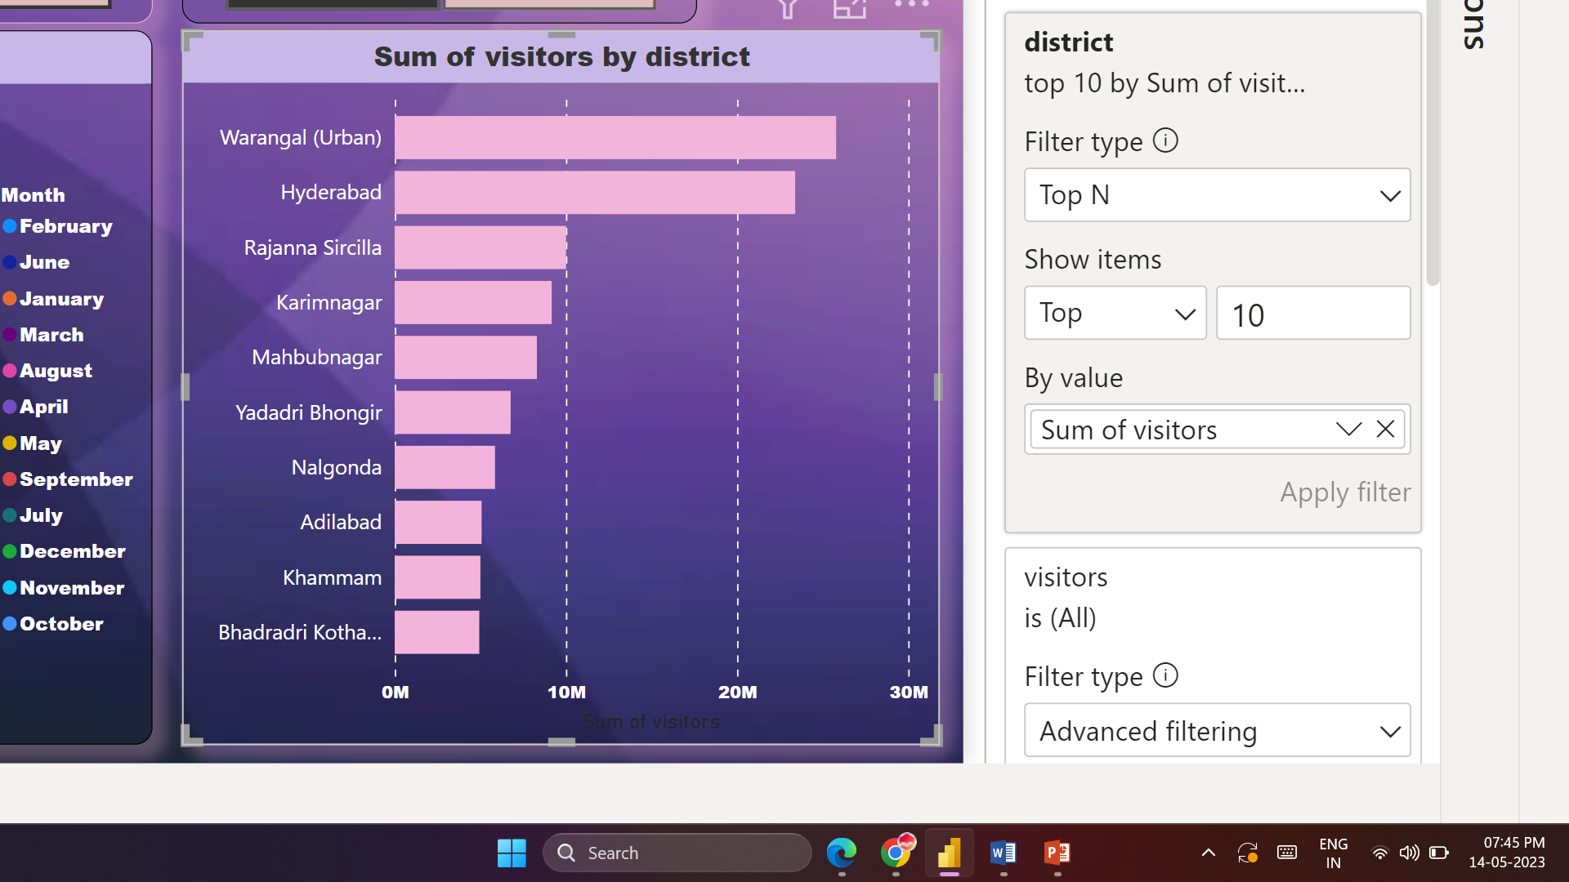
Preliminary Research Questions
1. List down top 10 districts having higher number of Domestic visitors( Overall 2016-2019)

Slide 4
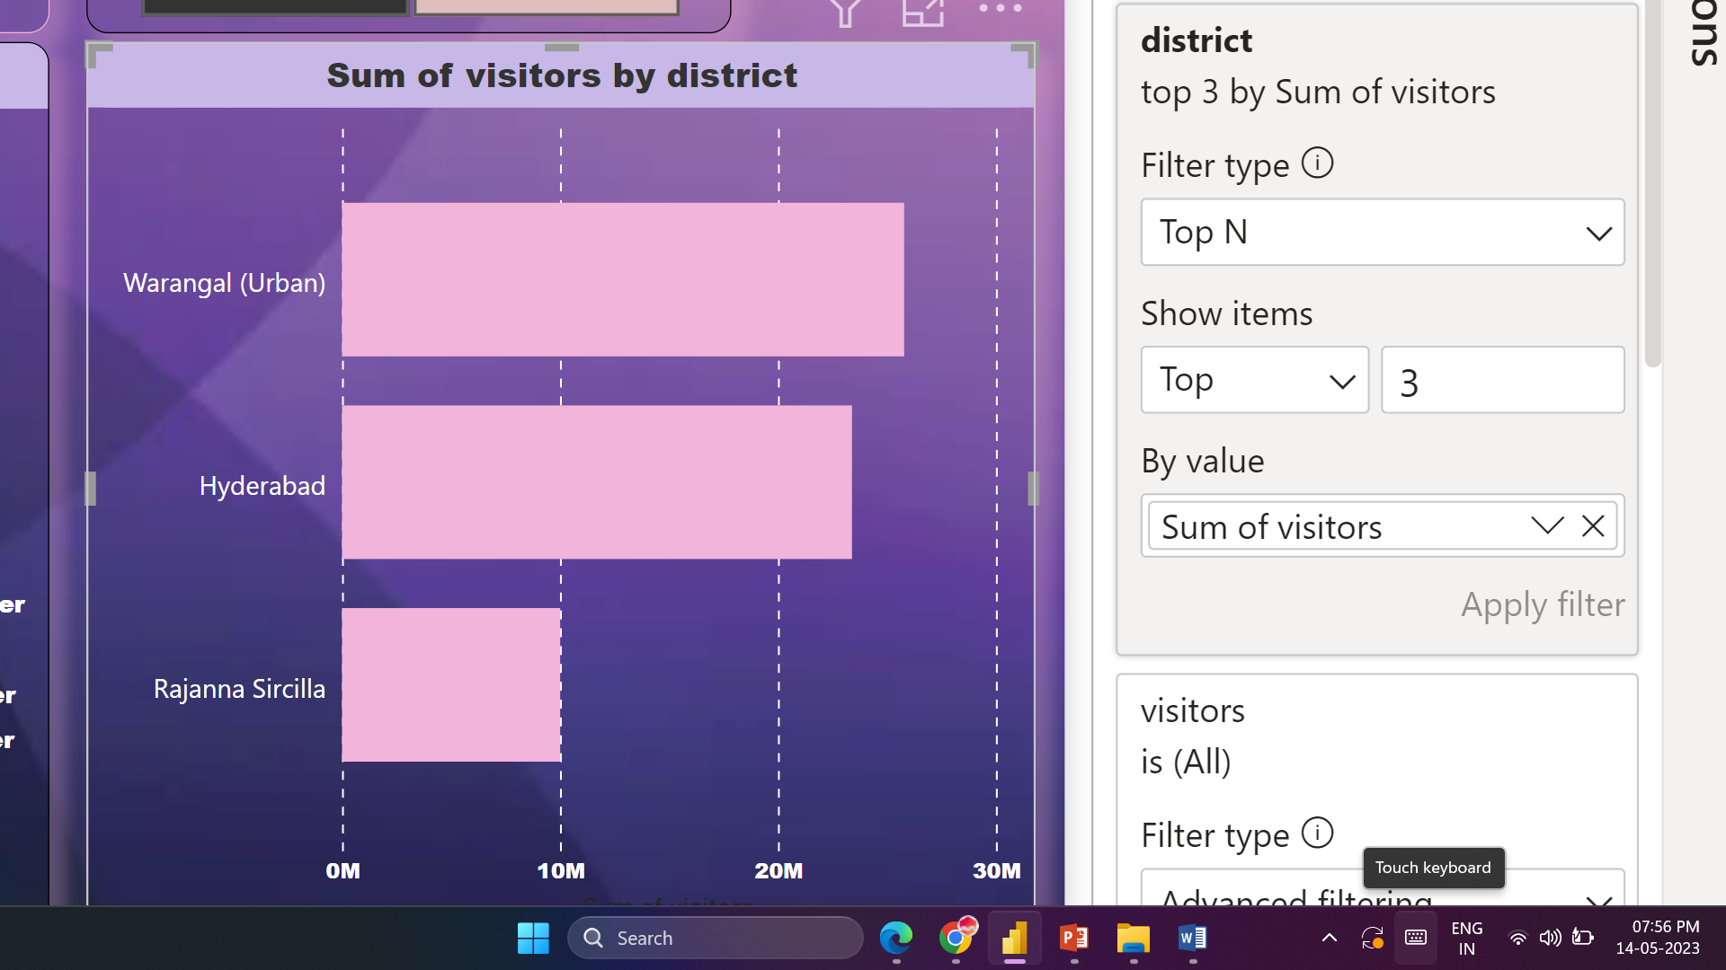
Preliminary Research Questions
2. List down top 3 districts based on compounded annual growth rate of visitors between(2016-2019)

Slide 5
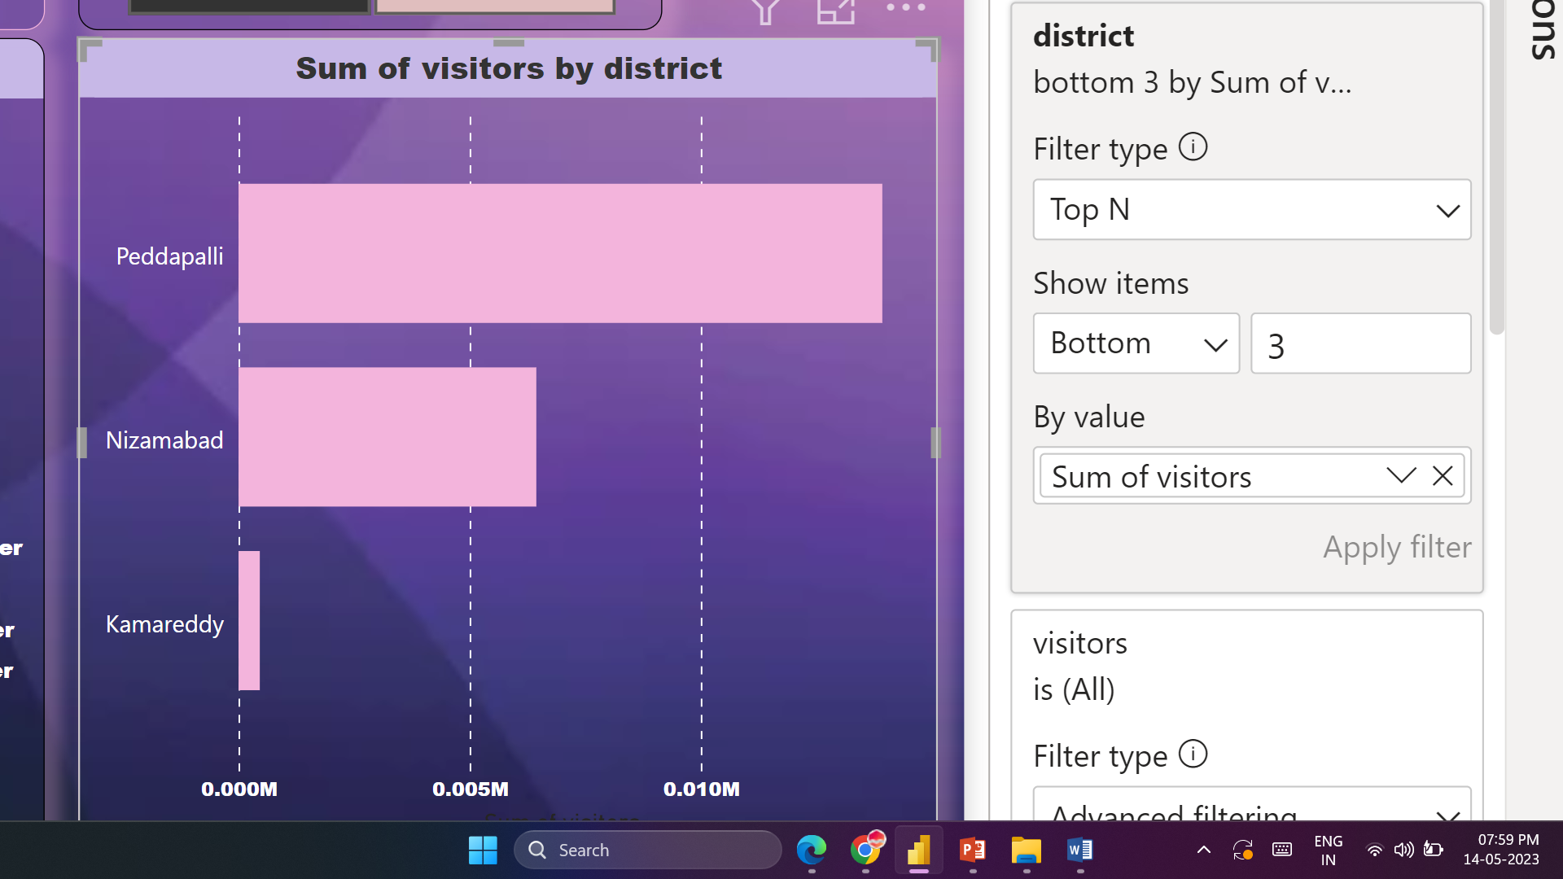
Preliminary Research Questions
3. List down bottom 3 districts based on compounded annual growth rate of visitors (2016-2019)

Slide 6
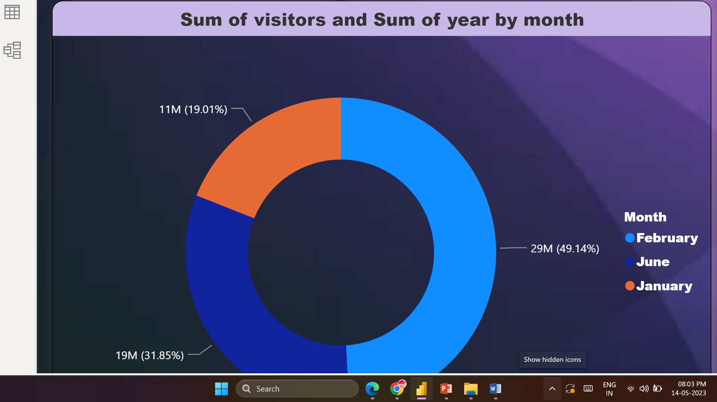
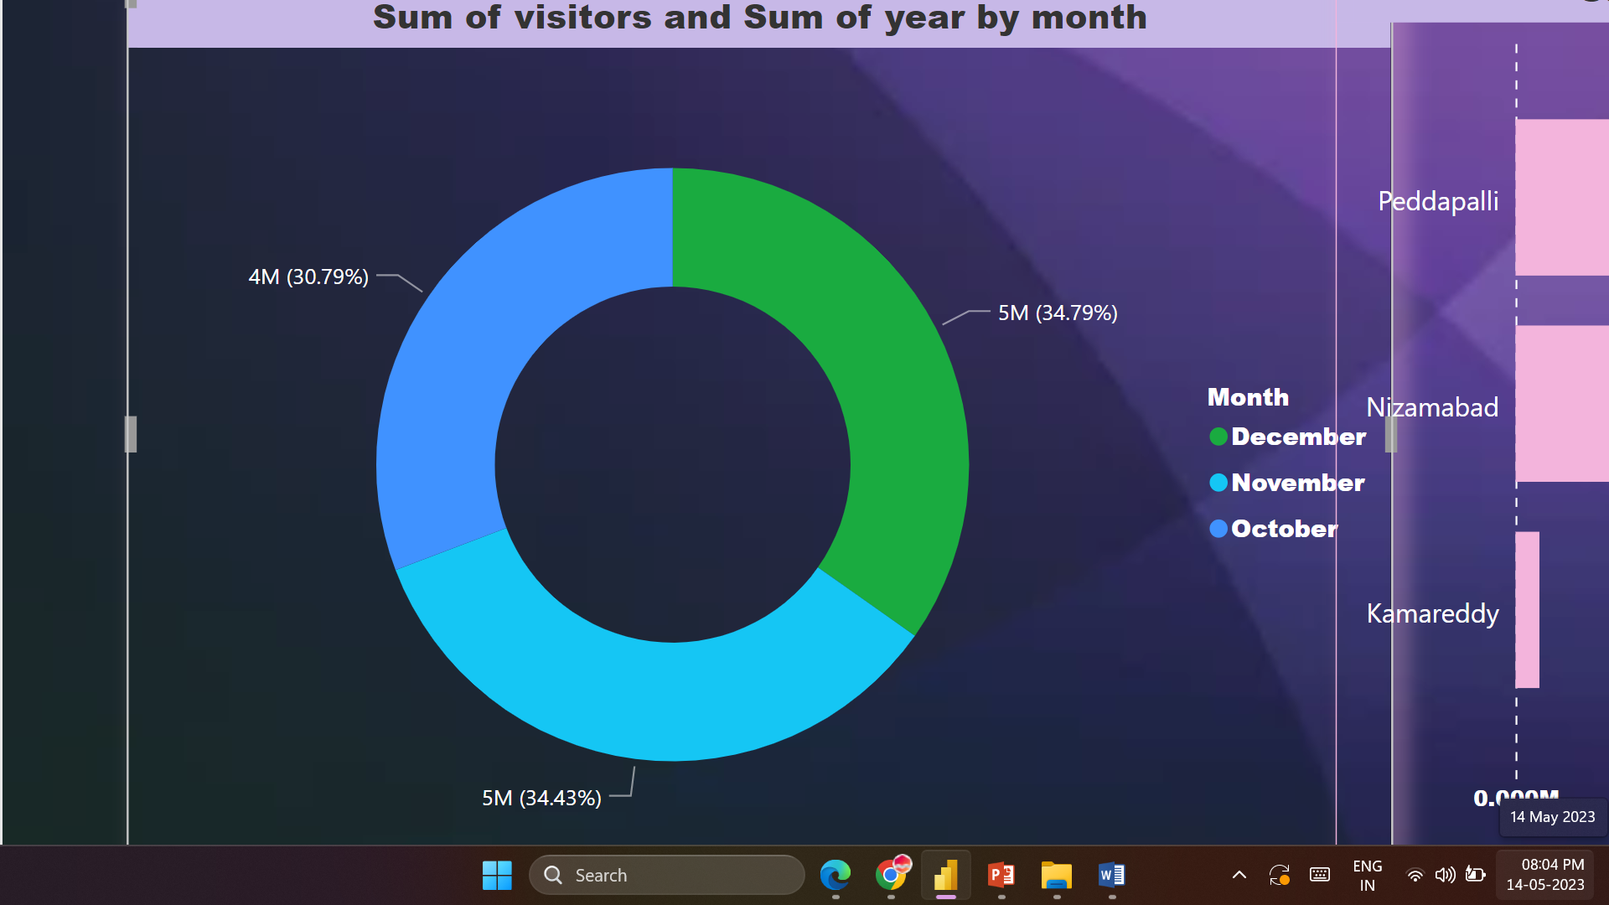
Preliminary Research Questions
4. Peak and Low season months for Hyderabad

